Slide 1
Spline Interpolation Method
by
Dr. Md. Rajibul Islam
CSE, UAP

Slide 2
Spline Method of Interpolation

Slide 3
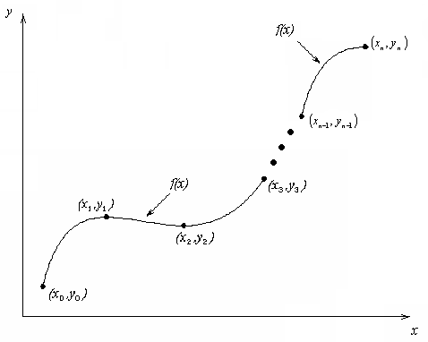
What is Interpolation ?
Given (x₀,y₀), (x₁,y₁), …… (x_{n},y_{n}), find the value of ‘y’ at a value of ‘x’ that is not given.

Slide 4

Interpolants
Polynomials are the most common choice of interpolants because they are easy to:
  Evaluate
  Differentiate, and
  Integrate.

Slide 5
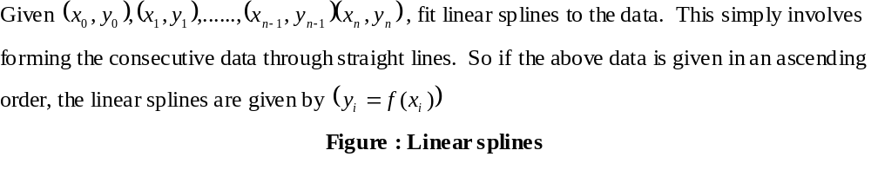
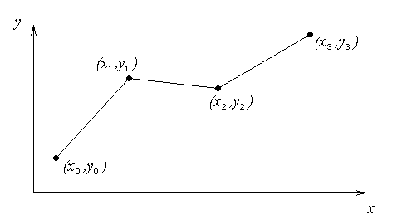
Linear Interpolation

Slide 6
Linear Interpolation
The data to linear splines,
X₀<x₁<x₂<…..<x_{n}
y
Interior knot¹
x₁, y₁
x_{i}, y_{i}
x_{n}, y_{n}
x₀, y₀
x₂, y₂
X_{i+1}, y_{i+1}
X_{n-1}, y_{n-1}
x
If you are going to find the value of f(x), you are considering only the straight line between 2 points. Other points are not considered for this calculation. That mean, you are using only limited information to find the value of y at x.
You will find that your derivative is suddenly changing at the interior knot. At this particular point, artificially you're going to get discontinuity in the acceleration, because the derivative is piecewise continuous.
¹ why it's called an interior knot, because it's an interior data point, and it's a knot because it is shared by two lines.

Slide 7
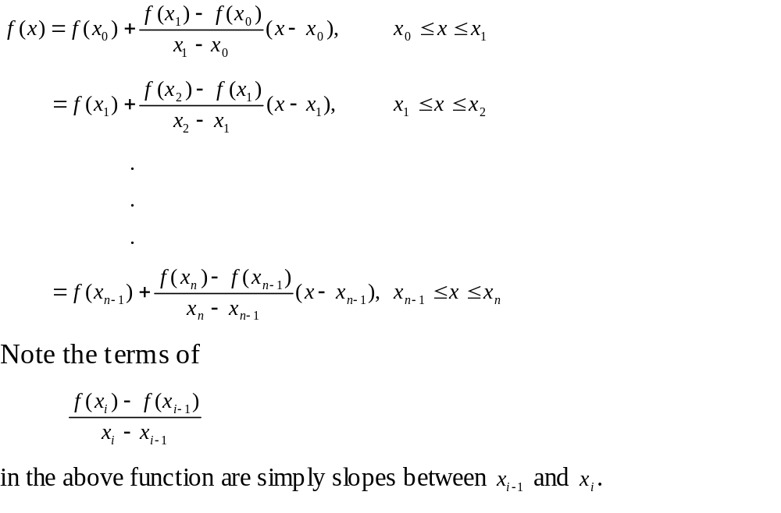
Linear Interpolation (contd)
General formula (Spline method)

Slide 8
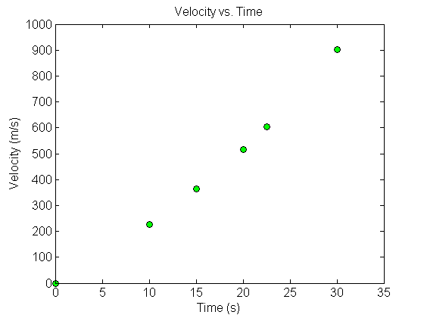



Example
The upward velocity of a rocket is given as a function of time in Table 1. Find the velocity at t=16 seconds using linear splines.
Table Velocity as a
function of time
(s) | (m/s)
0 | 0
10 | 227.04
15 | 362.78
20 | 517.35
22.5 | 602.97
30 | 901.67
Figure. Velocity vs. time data
for the rocket example

Slide 9
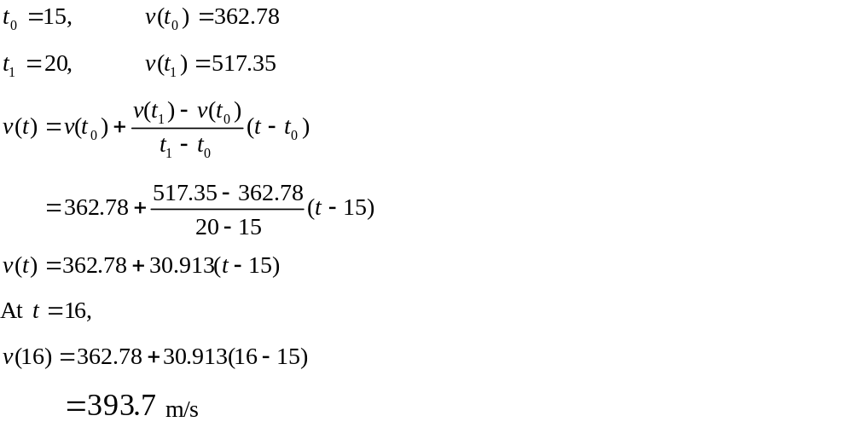
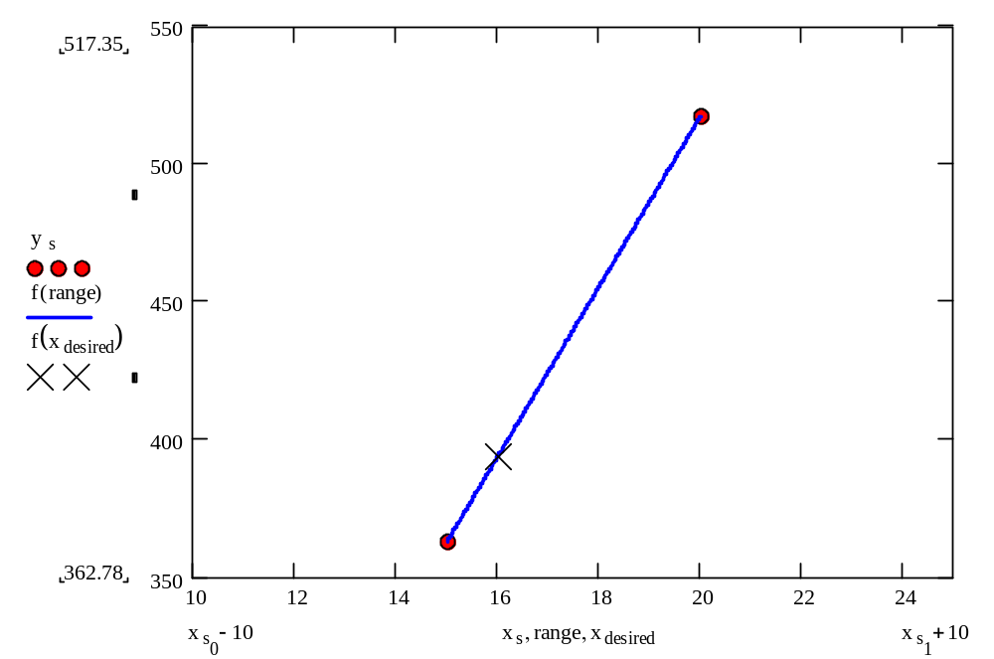
Linear Interpolation

Slide 10
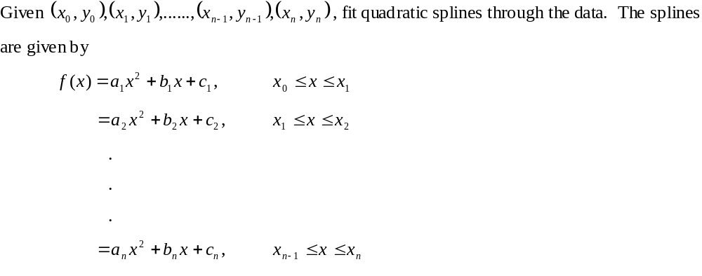
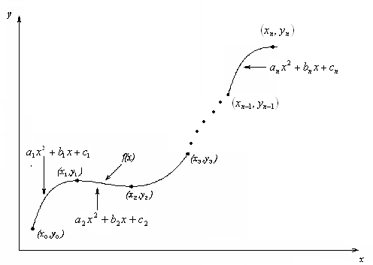
Quadratic Interpolation

Slide 11
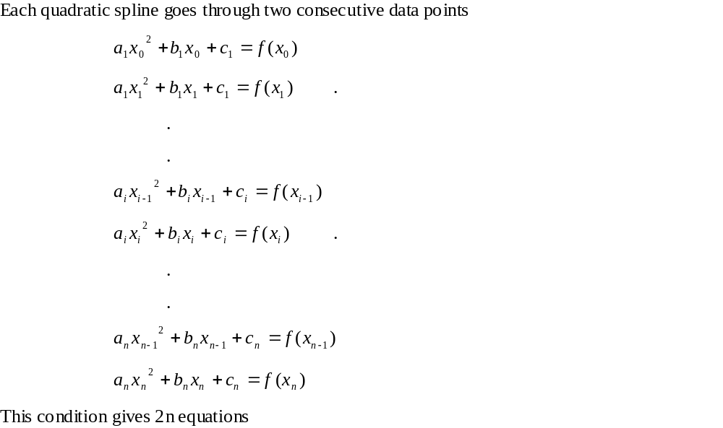
Quadratic Interpolation (contd)

Slide 12
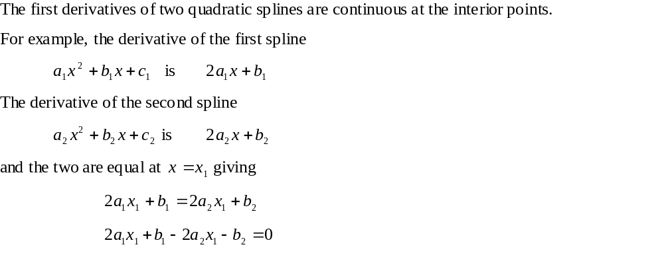
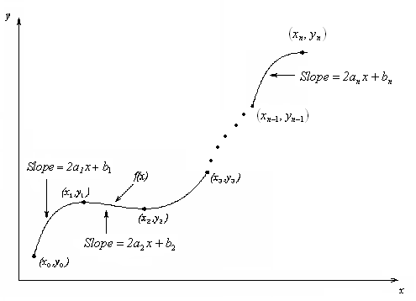
Quadratic Splines (contd)

Slide 13
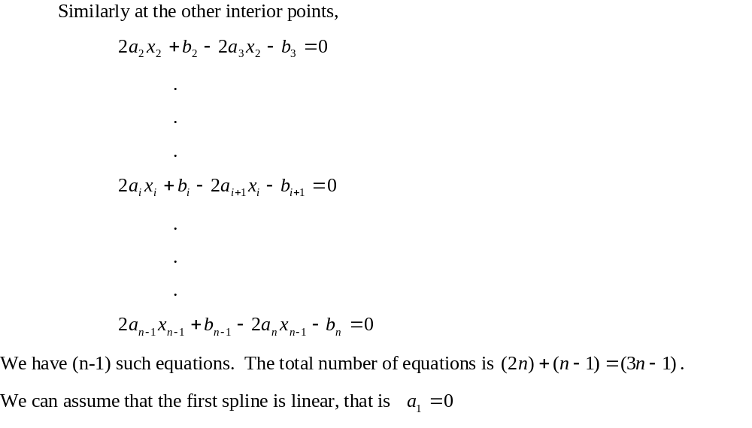
Quadratic Splines (contd)

Slide 14
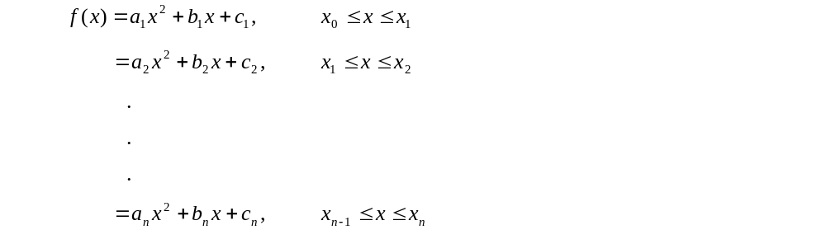
Quadratic Splines (contd)

Slide 15
Quadratic Spline Example
The upward velocity of a rocket is given as a function of time. Using quadratic splines
Find the velocity at t=16 seconds
Find the acceleration at t=16 seconds
Find the distance covered between t=11 and t=16 seconds
Table Velocity as a
function of time
(s) | (m/s)
0 | 0
10 | 227.04
15 | 362.78
20 | 517.35
22.5 | 602.97
30 | 901.67
Figure. Velocity vs. time data
for the rocket example

Slide 16
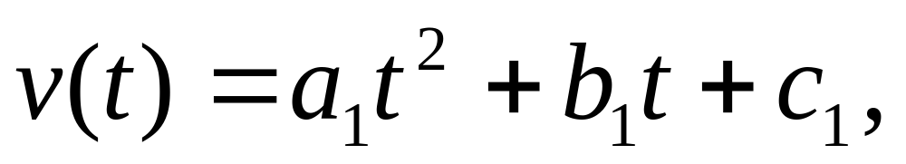
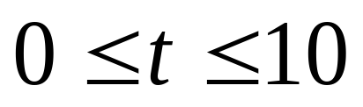
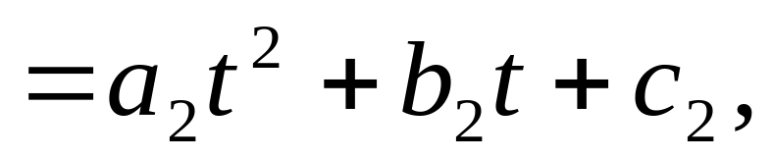
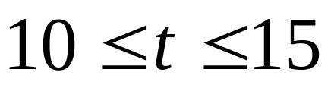
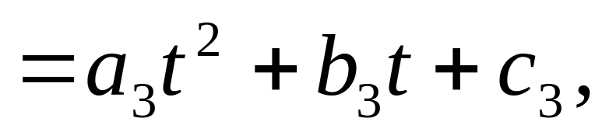

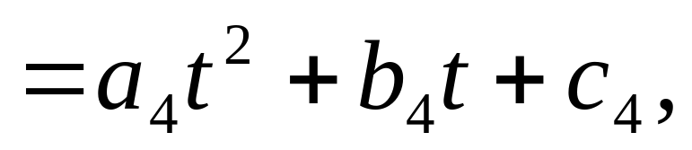
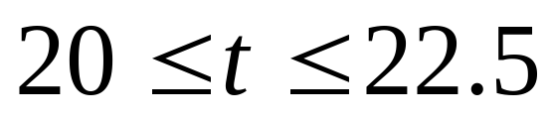
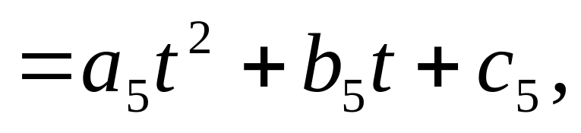
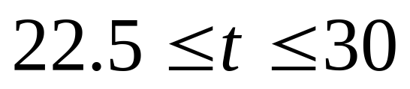
Solution
Let us set up the equations

Slide 17
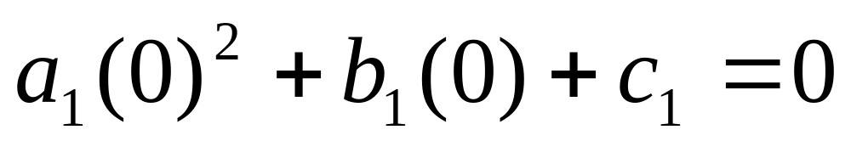
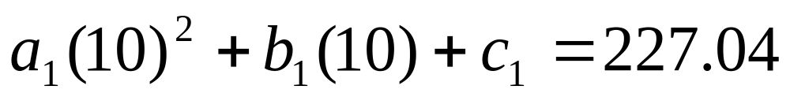
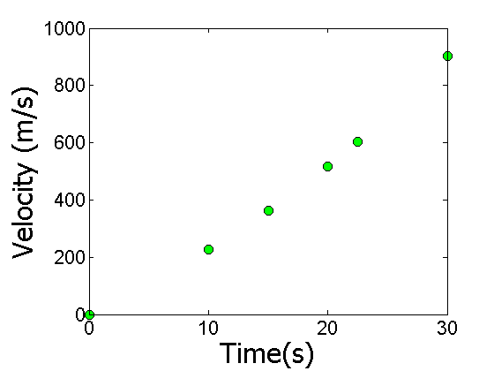
Each Spline Goes Through Two Consecutive Data Points
http://numericalmethods.eng.usf.edu

Slide 18
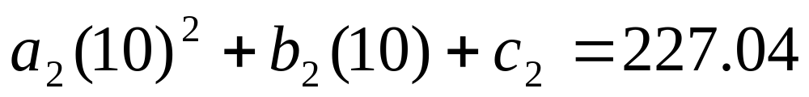
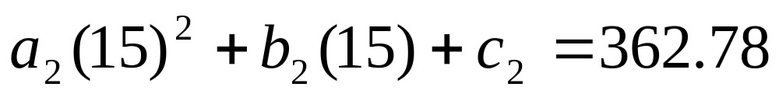
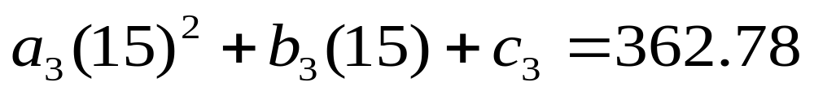
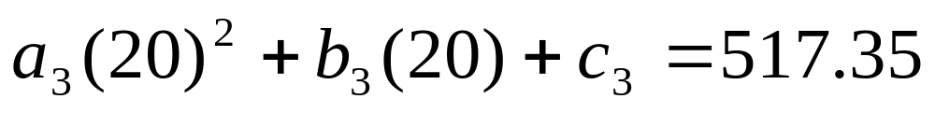
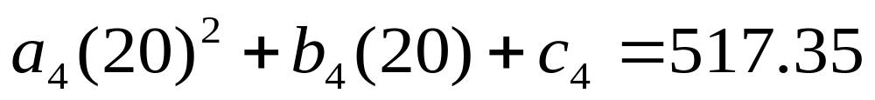
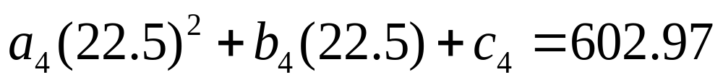
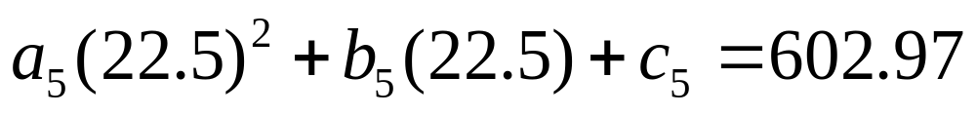
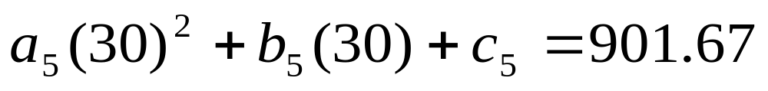
Each Spline Goes Through Two Consecutive Data Points
t | v(t)
s | m/s
0 | 0
10 | 227.04
15 | 362.78
20 | 517.35
22.5 | 602.97
30 | 901.67

Slide 19
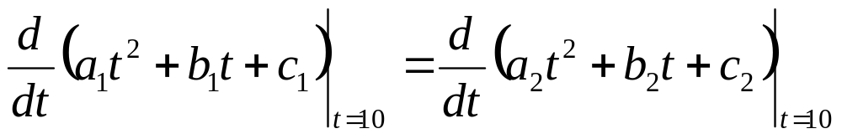
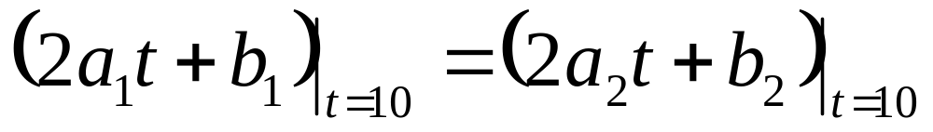
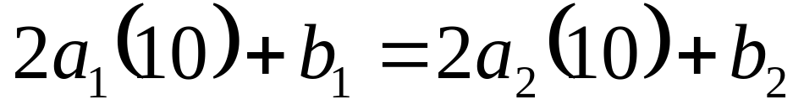
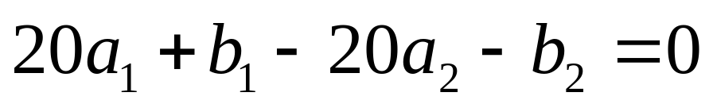
Derivatives are Continuous at Interior Data Points

Slide 20
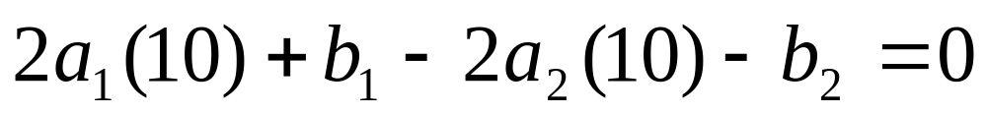
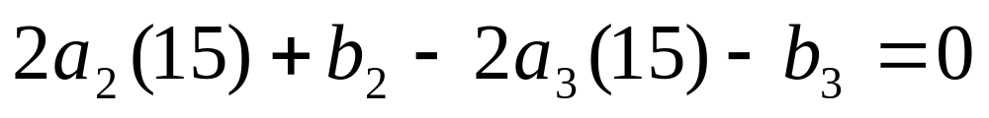
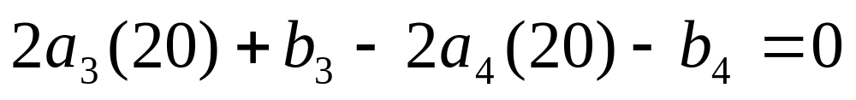
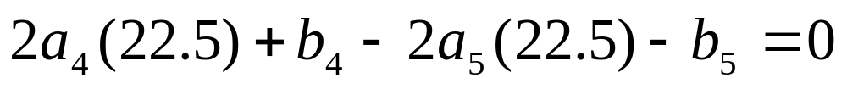
Derivatives are continuous at Interior Data Points
At t=10
At t=15
At t=20
At t=22.5

Slide 21
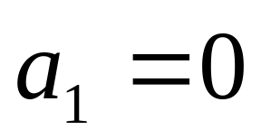
Last Equation

Slide 22
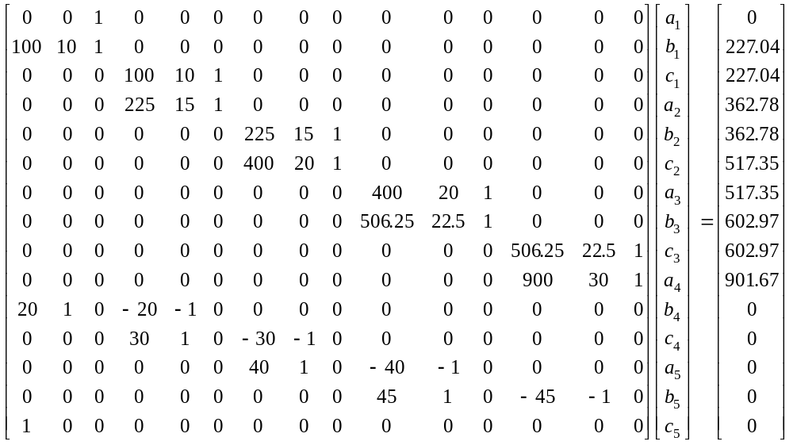
Final Set of Equations

Slide 23
Coefficients of Spline
i | a_{i} | b_{i} | c_{i}
1 | 0 | 22.704 | 0
2 | 0.8888 | 4.928 | 88.88
3 | −0.1356 | 35.66 | −141.61
4 | 1.6048 | −33.956 | 554.55
5 | 0.20889 | 28.86 | −152.13

Slide 24
Quadratic Spline Interpolation
Part 2 of 2

Slide 25


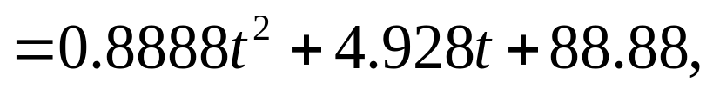

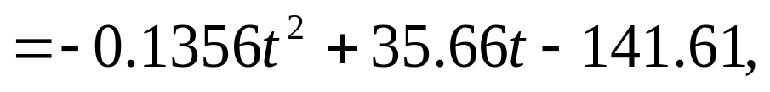

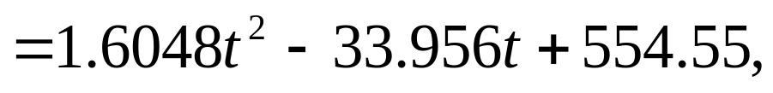

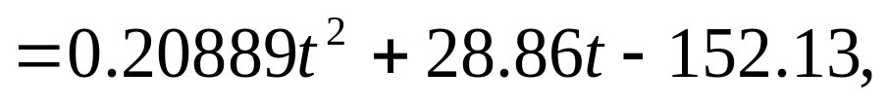

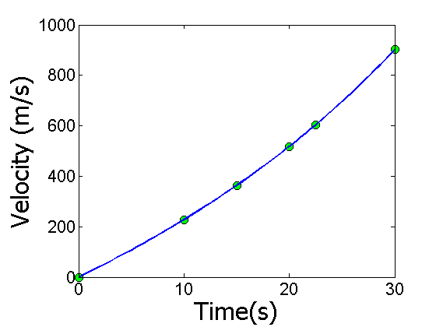
Final Solution

Slide 26
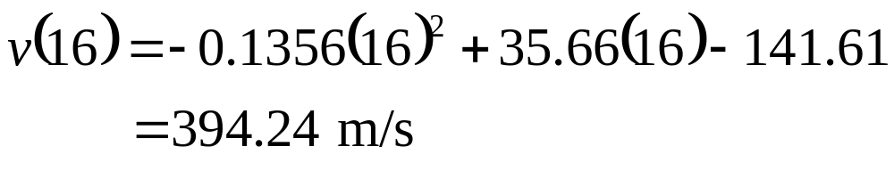
Velocity at a Particular Point
a) Velocity at t=16

Slide 27








Acceleration from Velocity Profile
b) The quadratic spline valid at t=16 is given by

Slide 28



Distance from Velocity Profile
c) Find the distance covered by the rocket from t=11s to t=16s.

Slide 29
THE END

